Slide 1
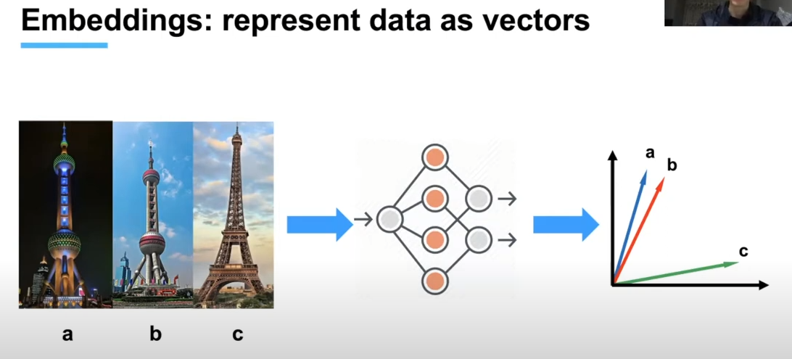
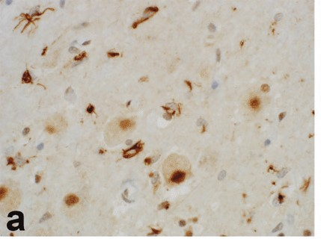
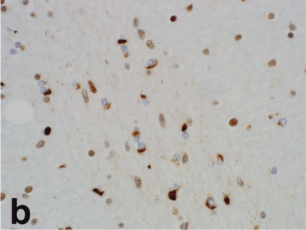
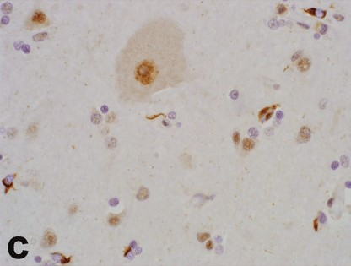
Embeddings Represent data as a n-Dimensional Vectors

Slide 2
Define Database/Collection Schema
Collection Schema
(name, description)
Field Schema 1
(name, dtype, dim)
Field Schema 1
(name, dtype, dim)
Field Schema 1
(name, dtype, dim)
Field Schema 1
(name, dtype, dim)

Slide 3
Collection = Table | Fields = Columns
Collection_1
COHORT 1 : ALS IMAGES
Image_Name | Image_id | Image_date | Image_vector
Heterogeneity-of-TDP-43-inclusion-pathology-A | 1 | 20240715 | [-0.6458381414413452, 0.38823872804641724, 0.7556256651878357, ……… ]
Heterogeneity-of-TDP-43-inclusion-pathology-B | 2 | 20240715 | [-0.1493655890226364, 0.9747080206871033, 1.119510293006897, ……… ]
Heterogeneity-of-TDP-43-inclusion-pathology-C | 3 | 20240715 | [0.166558176279068, 1.6846414804458618, 1.1219409704208374, ……… ]
Heterogeneity-of-TDP-43-inclusion-pathology-D | 4 | 20240715 | [-0.8779816031455994, 0.6956443786621094, 1.0266568660736084, ……… ]
Heterogeneity-of-TDP-43-inclusion-pathology-E | 5 | 20240715 | [-0.6858570575714111, 1.3880631923675537, 1.2627187967300415, ……… ]
Heterogeneity-of-TDP-43-inclusion-pathology-F | 6 | 20240715 | [-0.2884347438812256, 0.9208322167396545, 1.0908784866333008, ……… ]

Slide 4
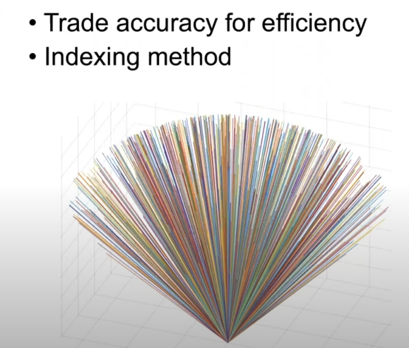
Image Vectors are so long indexing them makes cataloging more efficient

Slide 5
Next steps….
Add more images
Add metric for accuracy
Use RAG to improve Accuracy
Use other models and compare to resnet18

